Slide 1
DORAnet Workshop
Quan Zhang, Stefan Pate, William Sprague, Prof. Linda Broadbelt
BOTTLE 2024 All-Hands Meeting
BOTTLE Confidential

Slide 2
What is DORAnet?
GUI Layer
Module Layer
Chem
Bio
Hybrid
Kinetic (WIP)
Core Layer
Core Code
Interface Layer
Interfaces

Slide 3
What is DORAnet?
GUI Layer
TODAY
Module Layer
Chem
Bio
Hybrid
Kinetic (WIP)
Core Layer
Core Code
Interface Layer
Interfaces

Slide 4
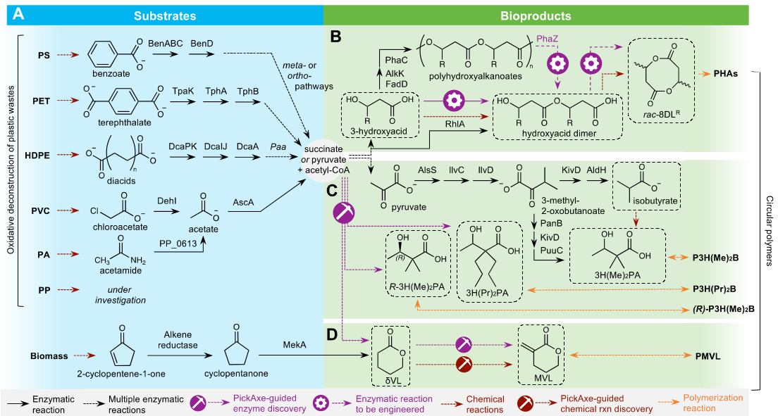
CASP can generate synthesis ideas for novel monomers
Allison Werner

Slide 5
Background: Computationally Aided Synthesis Planning (CASP) with DORAnet

Slide 6



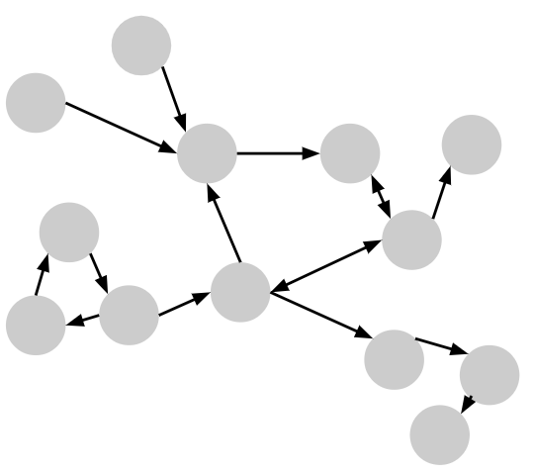
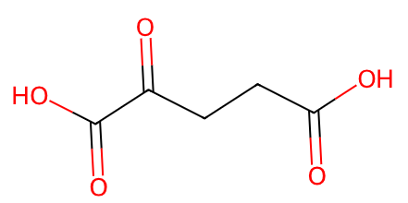
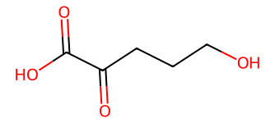
Overview of CASP with DORAnet
D
,
,
→
starting molecules
target molecules
operators

Slide 7
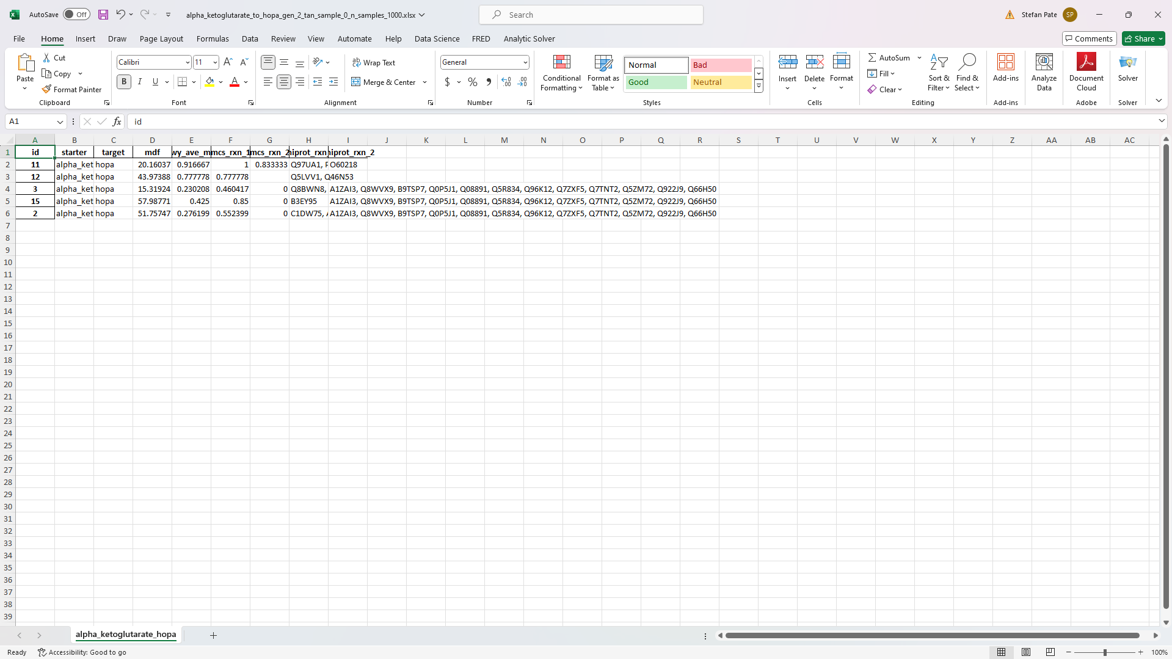
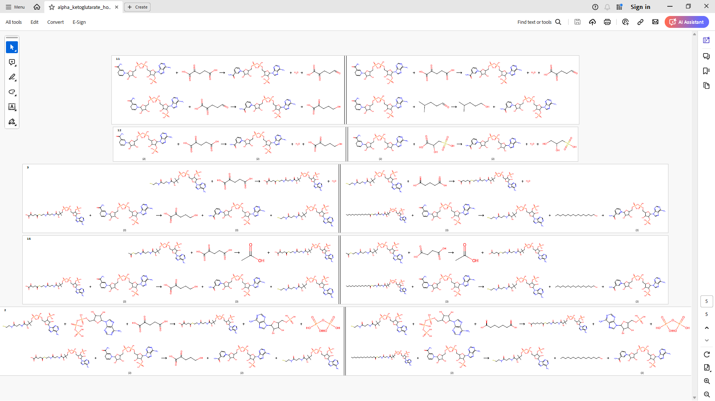
Overview of CASP with DORAnet
1
D
,
,
→
starting molecules
target molecules
operators
2
→
Filtering &
post-processing
→

Slide 8
Overview of CASP with DORAnet
1
D
,
,
→
starting molecules
target molecules
operators
2
→
Filtering &
post-processing
→
Bio
Chem

Slide 9
Overview of CASP with DORAnet
1
D
,
,
→
starting molecules
target molecules
operators
2
→
Filtering &
post-processing
→

Slide 10
Background: Operators

Slide 11
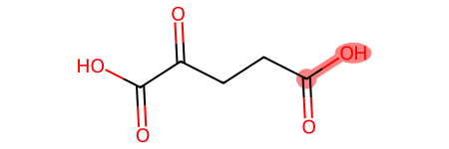
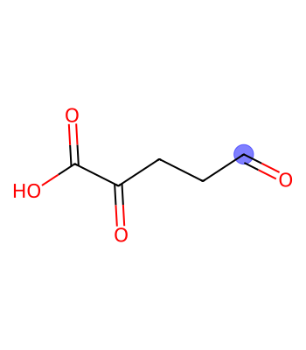
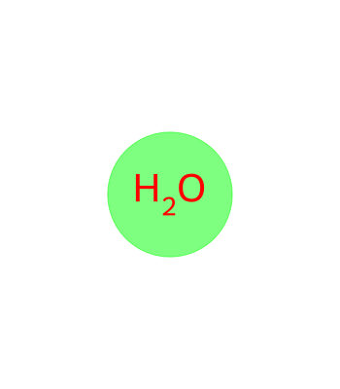
Operators codify & implement chemical transformations in silico
+
NADH
NAD⁺
+
[C:0]-[O:1]>>[C:0].[O:1]

Slide 12
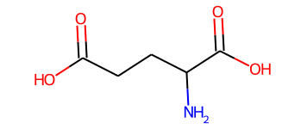
First, let’s consider CASP without operators
Glutamate synthase
(1.4.1.14)
Bio
Chem

Slide 13
First, let’s consider CASP without operators
Glutamate synthase
(1.4.1.14)
This network of known enzymatic reactions is incomplete…
Bio
Chem

Slide 14
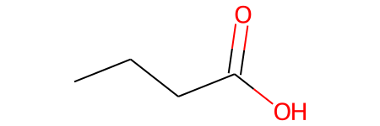
One-enzyme-one-substrate gives way to enzyme promiscuity
ILLUSTRATIVE
Enzyme: NICar
K_{cat} / K_{M}
Tawfik, 2010. Ann. Rev. Biochem.
Arnold, 2018. Ang. Chem. Int.
Bio
Chem

Slide 15
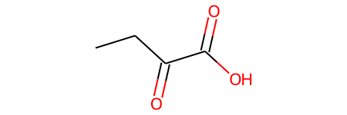
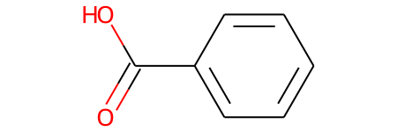
One-enzyme-one-substrate gives way to enzyme promiscuity
ILLUSTRATIVE
Enzyme: NICar
K_{cat} / K_{M}
Substrate structure
Tawfik, 2010. Ann. Rev. Biochem.
Arnold, 2018. Ang. Chem. Int.
Bio
Chem

Slide 16
One-enzyme-one-substrate gives way to enzyme promiscuity
ILLUSTRATIVE
Enzyme: NICar
K_{cat} / K_{M}
Enzymes catalyze reactions on more than one substrate
Catalytic efficiency is similar for structurally similar substrates
Substrate structure
Tawfik, 2010. Ann. Rev. Biochem.
Arnold, 2018. Ang. Chem. Int.
Bio
Chem

Slide 17
One-enzyme-one-substrate gives way to enzyme promiscuity
ILLUSTRATIVE
Enzyme: NICar
K_{cat} / K_{M}
Enzymes catalyze reactions on more than one substrate
Catalytic efficiency is similar for structurally similar substrates
Substrate structure
Tawfik, 2010. Ann. Rev. Biochem.
Arnold, 2018. Ang. Chem. Int.
Bio
Chem

Slide 18
Let’s now look at operators; consider this reaction for example
+
NADH
NAD⁺
+
[C:0]-[O:1]>>[C:0].[O:1]
Bio
Chem

Slide 19
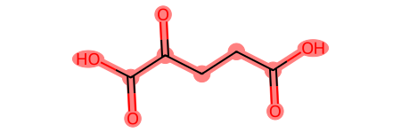
Enzymatic operators codify these two assumptions…
PERMISSIVENESS
CATALYTIC EFFICIENCY
r=inf
substructure:
Bio
Chem

Slide 20
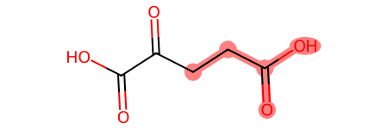
Enzymatic operators codify these two assumptions…
PERMISSIVENESS
CATALYTIC EFFICIENCY
r=inf
r=2
substructure:
Bio
Chem

Slide 21
Enzymatic operators codify these two assumptions…
PERMISSIVENESS
CATALYTIC EFFICIENCY
r=inf
r=2
r=0
substructure:
Bio
Chem

Slide 22
Enzymatic operators codify these two assumptions…
PERMISSIVENESS
CATALYTIC EFFICIENCY
r=inf
r=2
r=0
substructure:
# known compounds w/ matching substructure:
8
3,250
7,759
Bio
Chem

Slide 23
…allowing a search among predicted missing paths
Default enzymatic operators in DORAnet assume intermediate level of promiscuity
Bio
Chem

Slide 24
Chemical Reaction Rules (Operators)
382 chemical rules were curated by hand, two separate lists for forward and retrosynthesis
From organic chemistry textbooks, published papers, etc.
Reaction rules are written in SMARTS (SMILES arbitrary target specification)
Example: Hydrogenation of Alkenes
SMARTS : [C+0:1]=[C+0:2].[H][H]>>[*:1][*:2]
Bio
Chem

Slide 25
Background: Network expansion strategies

Slide 26
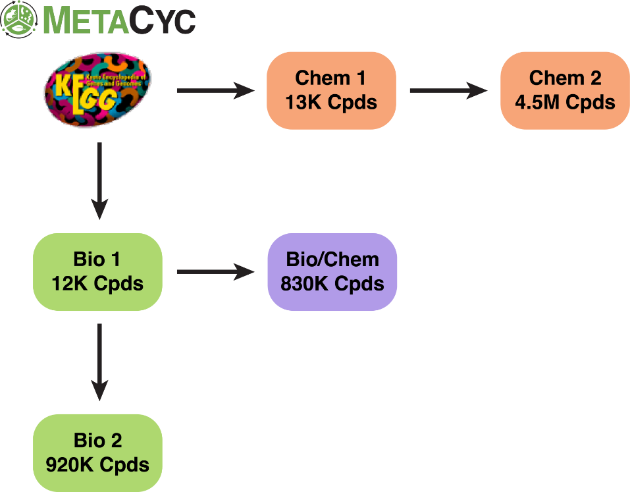
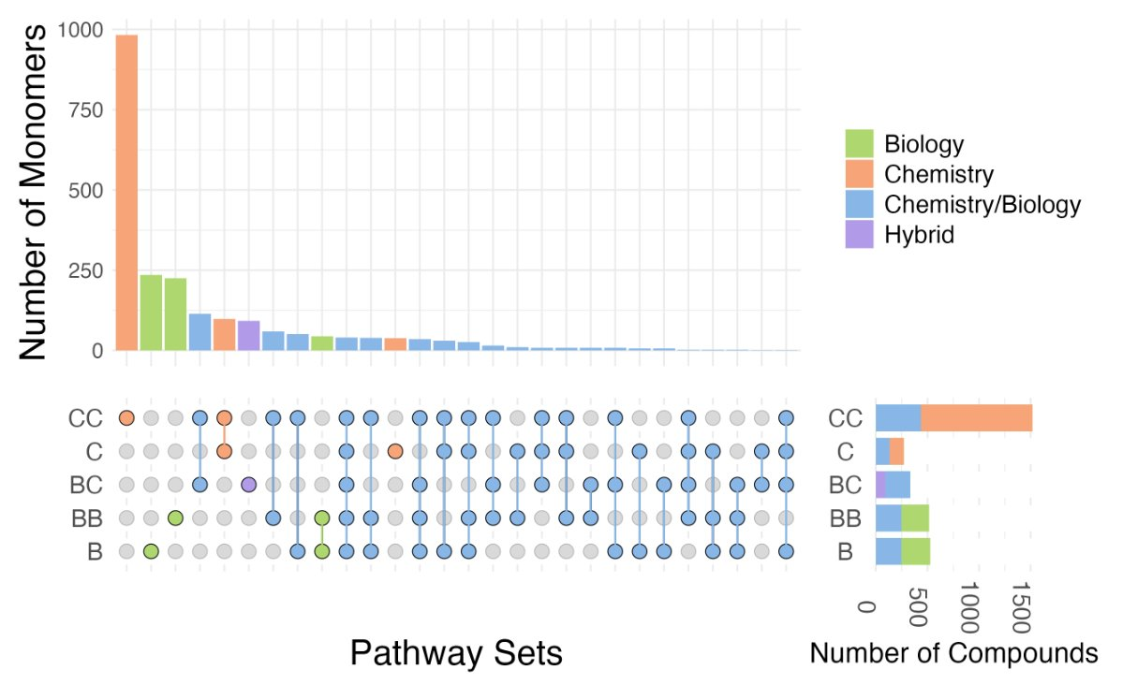
Combining bio & chem operators accesses more molecules
6.3M total compounds generated
2,186 target monomers
Shebek et al., in preparation

Slide 27
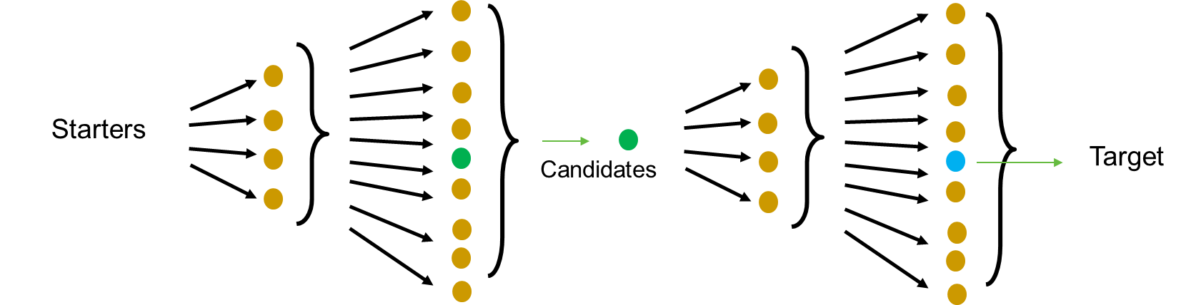
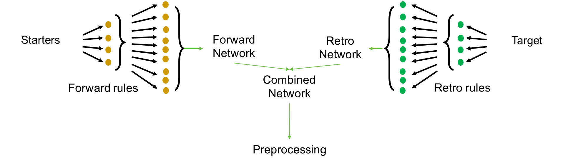
Combining forward & retro expansions saves memory
Forward:
Retro:
Combined:

Slide 28

Q&A

Slide 29
Demo: Network expansion

Slide 30
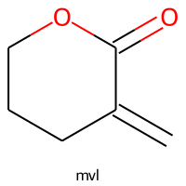
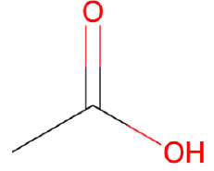
We’ll demonstrate DORAnet w/ 2 paths predicted for BOTTLE
Bio
(2 steps)
Chem
&
Hybrid
Selected feedstocks
(2 steps)

Slide 31
Overview of CASP with DORAnet
1
D
,
,
→
starting molecules
target molecules
operators
2
→
Filtering &
post-processing
→

Slide 32
Background: Filtering & post-processing

Slide 33
We saw w/ just 2 steps how quickly the reaction count grows
Bio
156,000 reactions
(2 steps)
Chem
Selected feedstocks
202,508 reactions
(2 steps)
Estimated average # of predicted reactions: 1,348 ± 91 for bio operators alone

Slide 34
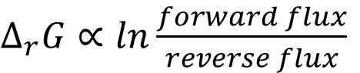
Most helpful filters: (1) thermodynamics
$Δ_{r}G∝ln\frac{forward flux}{reverse flux}$
Noor et al., 2014. PLoS Comp. Bio.
Beard & Qian, 2007. PLoS ONE
Haldane, 1930. Longmans, London.
Bio
Chem

Slide 35
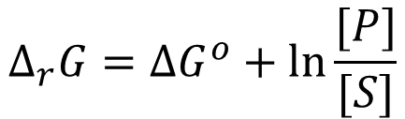
Most helpful filters: (1) thermodynamics
$Δ_{r}G∝ln\frac{forward flux}{reverse flux}$
$$Δ_{r}G=ΔG^{o}+ln⁡\frac{[P]}{[S]}$$
Noor et al., 2014. PLoS Comp. Bio.
Beard & Qian, 2007. PLoS ONE
Haldane, 1930. Longmans, London.
Bio
Chem

Slide 36
Most helpful filters: (1) thermodynamics
$Δ_{r}G∝ln\frac{forward flux}{reverse flux}$
$$Δ_{r}G=ΔG^{o}+ln⁡\frac{[P]}{[S]}$$
Property of the substrates → estimate with group contribution theory
Noor et al., 2014. PLoS Comp. Bio.
Beard & Qian, 2007. PLoS ONE
Haldane, 1930. Longmans, London.
Bio
Chem

Slide 37
Most helpful filters: (1) thermodynamics
$Δ_{r}G∝ln\frac{forward flux}{reverse flux}$
$$Δ_{r}G=ΔG^{o}+ln⁡\frac{[P]}{[S]}$$
Property of the substrates → estimate with group contribution theory
Function of substrate concentrations → optimize within physiological constraints
Noor et al., 2014. PLoS Comp. Bio.
Beard & Qian, 2007. PLoS ONE
Haldane, 1930. Longmans, London.
Bio
Chem

Slide 38
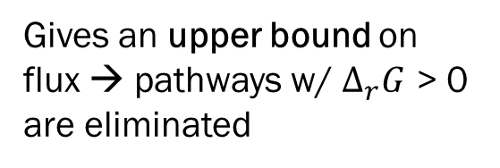
Most helpful filters: (1) thermodynamics
$Δ_{r}G∝ln\frac{forward flux}{reverse flux}$
$$Δ_{r}G=ΔG^{o}+ln⁡\frac{[P]}{[S]}$$
Gives an upper bound on flux → pathways w/ $Δ_{r}G$ > 0 are eliminated
Property of the substrates → estimate with group contribution theory
Function of substrate concentrations → optimize within physiological constraints
Noor et al., 2014. PLoS Comp. Bio.
Beard & Qian, 2007. PLoS ONE
Haldane, 1930. Longmans, London.
Bio
Chem

Slide 39
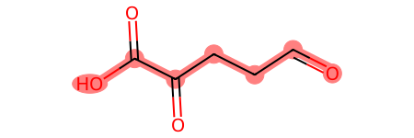
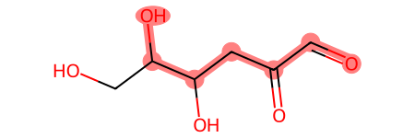
Most helpful filters: (2) structural similarity to known substrate
Predicted
Known
Reaction center MCS Score
vs.
0.64
Bio
Chem

Slide 40
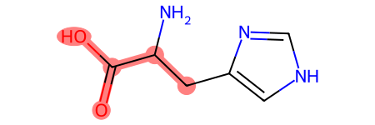
Most helpful filters: (2) structural similarity to known substrate
Predicted
Known
Reaction center MCS Score
vs.
0.64
vs.
0.45
Bio
Chem

Slide 41
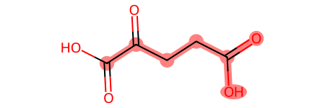
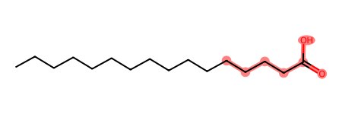
Most helpful filters: (2) structural similarity to known substrate
Predicted
Known
Reaction center MCS Score
vs.
0.64
vs.
0.45
vs.
0.39
Bio
Chem

Slide 42
Other information pulled from UniProt
Amino acid sequence
Organism
Level of evidence (protein, transcript, or homology)
EC number
UniProt ID
Bio
Chem

Slide 43
Useful Filters
Thermodynamic filter
Needs thermodynamic calculator functions from the user
Maximum atoms filter
max_atoms = {"C": 20,
"O": 10,}
Multiple reactants filter
allow_multiple_reactants
default = True for chem forward expansion
default = False for chem retro and bio expansion
Custom filters
Users can code their own filters in python with RDKit
Bio
Chem

Slide 44
Q&A

Slide 45
Demo: Filtering & post-processing

Slide 46
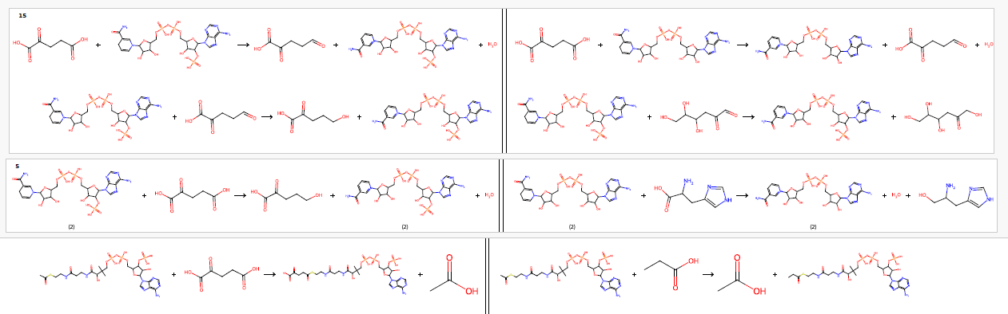
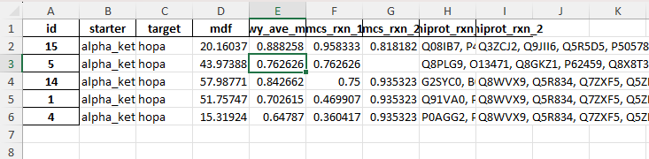
Final output documents
Side-by-side reaction drawings (.pdf)
More info on pathways (.xls)
One pathway
UniProt IDs to access more info
Predicted reaction
Known reaction
In the works: a more dynamic version that will speed up the review of this output
Bio
Chem

Slide 47
One-step Post-processing Arguments (Most Are Optional)
post_processing.one_step(
networks=None,
total_generations=1,
starters=None,
helpers=None,
target=None,
job_name="default_job_name",
search_depth="default",
max_num_rxns="default",
min_rxn_atom_economy=0.3,
weights=None,
num_process=1,
cool_reactions=None,
remove_pure_helpers_rxns=False,
sanitize=True,
transform_enols_flag=False,
molecule_thermo_calculator=None,
max_rxn_thermo_change=15,
consider_name_difference=True,
reaxys_result_name=None,
exclude_smiles=None,
reaxys_rxn_color="blue",
normal_rxn_color="black",
)
Bio
Chem

Slide 48
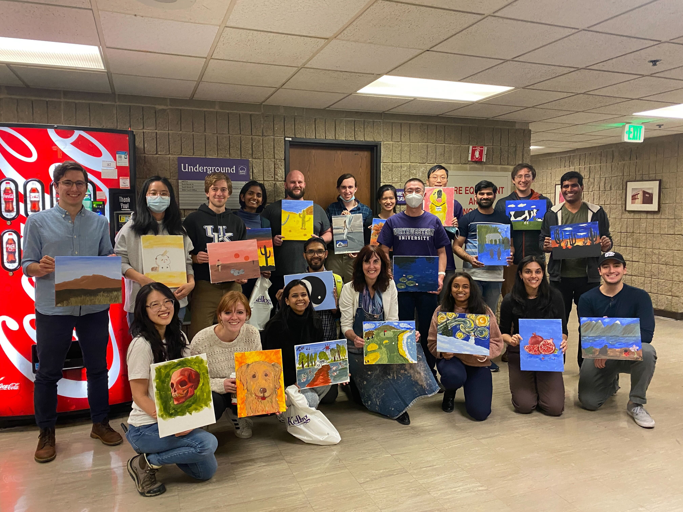


Acknowledgements
Acknowledgements
Broadbelt research group
James Gerken
BETO project

Slide 49
Q&A

Slide 50
Backup

Slide 51
Installation: DORAnet

Slide 52
Virtual Environment
Miniconda or Anaconda Installation
Download the installer
Miniconda https://docs.anaconda.com/free/miniconda/
Anaconda https://docs.anaconda.com/free/anaconda/install/
Run the installer
Follow the on-screen instructions
Use conda with command line
Linux and mac: open the built-in terminal
Windows: open the Anaconda Powershell Prompt

Slide 53
Create and Activate an Environment
If you already have an environment to install DORAnet
If you want to create a new environment to install DORAnet
conda activate your_env_name
conda create -n your_env_name python=3.10
conda activate your_env_name

Slide 54
Install DORAnet
Install
Update DORAnet (In the Future)
pip install doranet
pip install doranet --upgrade

Slide 55
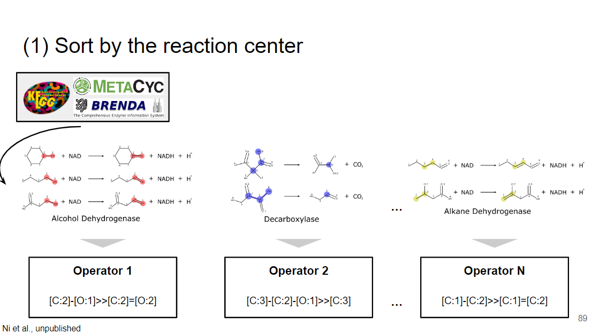
Intermediate operator construction (1)

Slide 56
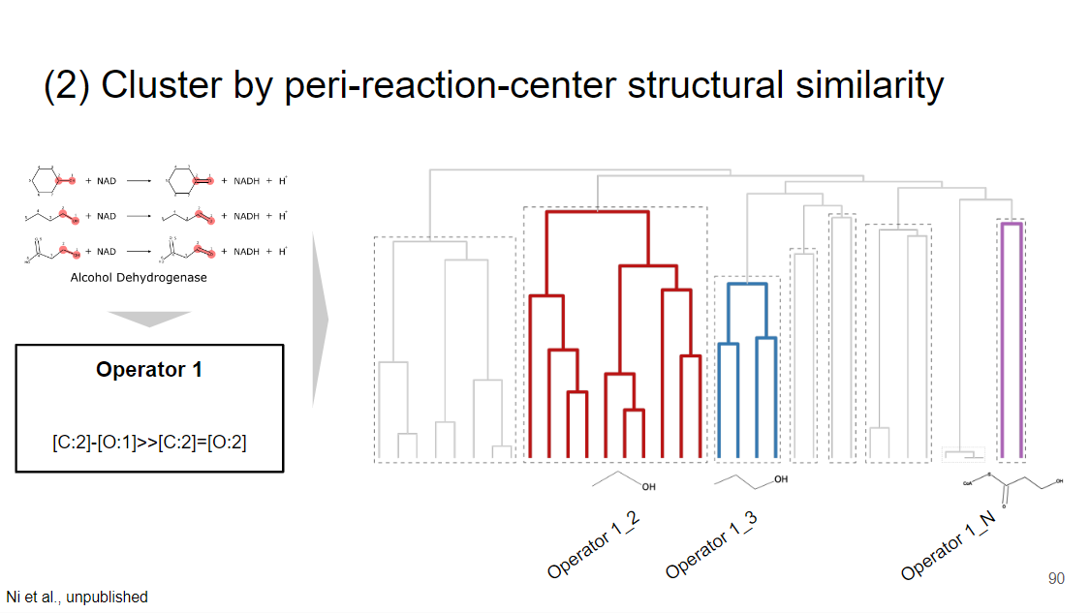
Intermediate operator construction (2)

Slide 57
Coming soon: [Hybrid pathways, kinetics…]

Slide 58
[William highlight new things in development]

Slide 59
What is DORAnet?
DORAnet is a Python framework for chemical network generation and analysis, intended to implement and extend the common functionality of tools previously used in the Broadbelt group for:
Chemo-catalytic synthesis planning
Enzymatic synthesis planning
Enzymatic product screening
Rate-based kinetic network expansion
DORAnet is licensed under the open-source Apache License Version 2

Slide 60
DORAnet Levels of Detail
Levels of Detail
GUI Layer
More accessible interface to various modules
Not yet implemented, contributions welcome!
GUI Layer
Module Layer^{1,2,3,4}
Each module implements a complex sets of assumptions about network type and structure for a particular domain application
Example: enzymatic networks use enzyme transforms and free energy filters; kinetic networks use radical rearrangements, rate-based expansion, and transition state theory
Module Layer
Core Layer
Core Layer^{1,2}
Toolbox of code implementing common assumptions shared between many domain areas
Example: a molecule is associated with a SMILES string
Interface Layer
Interface Layer¹
Definitions of relationships between fundamental objects like Molecules, Operators, and Networks
Very few assumptions about network structure
No implementation code
¹William Sprague, ²Quan Zhang, ³Stefan Pate, ⁴Geoffrey Bonnanzio

Slide 61
